Slide 1
Pattern formation.
Name: Erdemee Temuulen
Email : hdy4kt@inf.elte.hu
ID : HDY4KT

Slide 2
CVT calculator [part 1]
Goal : Spread the points inside the given shape evenly.
task 1: Randomly allocate N number of points inside the given shape.
task 2 : Find voronoi tessellation
task 3 : Find the centroid for each of them.
task 4 : Move the point to center
task 5 : Iterate until it reaches optimal

Slide 3
Path finder [part 2]
Goal : Find the path until closest point from the current position.
task 1 : Randomly put N number of food and agents in the env
task 2 : Make the agents find the food 1 for each
task 3 : If agent finds the food wait until others find the food

Slide 4
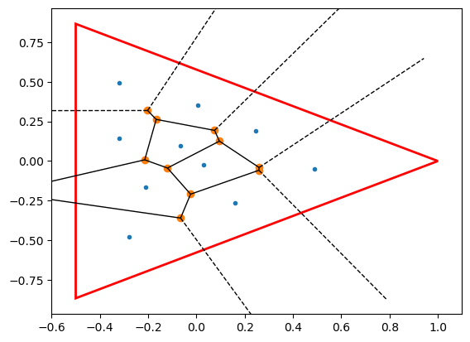
Environment [cvt calculator]
Custom
2D math plotting
N number of points
Given simple shape

Slide 5
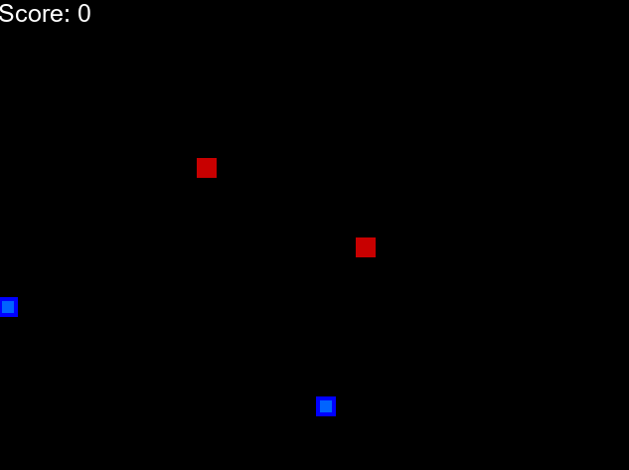
Environment [path finder]
Custom
2D pygame
1 agent type
Finder
1 reward type
Food [goal position]

Slide 6
Observation spaces
[danger straight, danger right, danger left,
direction left, direction right,
direction up, direction down,
food left, food right,
food up, food down
]
Directions
Foods position
Agents position
Border position

Slide 7
Action spaces
Up
Down
Left
Right
Stay

Slide 8
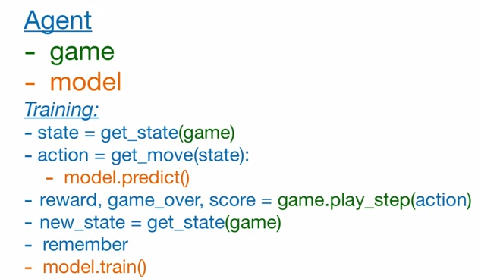
Models and Policies
Models
Linear_QNet(DQN)
Policie
Q-learning

Slide 9

Rewards
Positive
Food
Negative
Distance
Collision with each other
Collision with boundary

Slide 10
Evaluation metrics [CVT calculator]
distance between closest points
Area of the voronoi
test 1
num_generators = 50
num_iterations = 100
num_samples = 10000
test 2
num_generators = 10
num_iterations = 100
num_samples = 10000

Slide 11
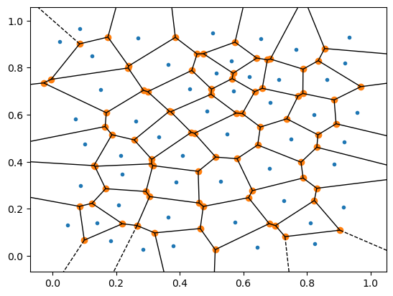
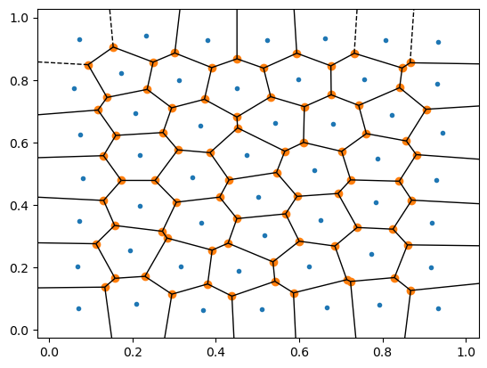
Result [CVT calculator 1]

Slide 12
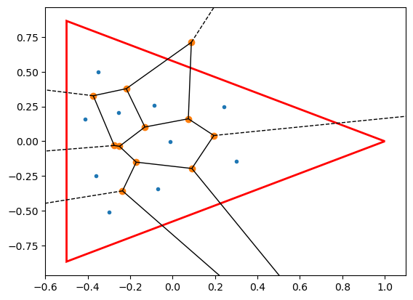
Result [CVT calculator 2]

Slide 13
Evaluation metrics [path finder]
Travel time = distance
Avg score
Number of iterations
Record score

Slide 14
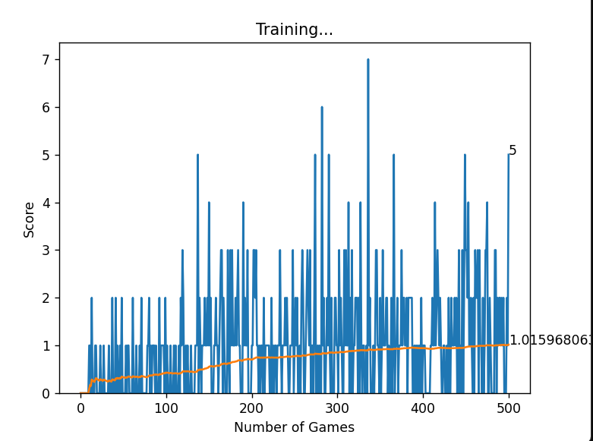
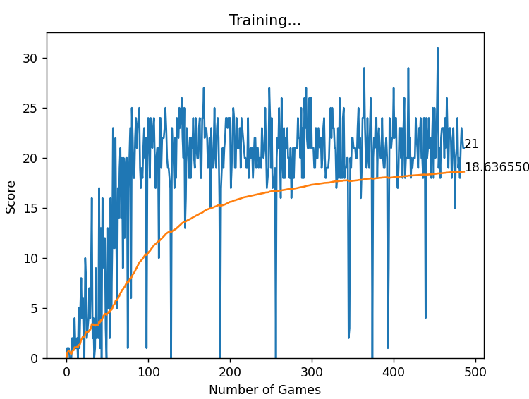
Results [path finder]

Slide 15
Conclusion and Further Work Example
Conclusion
Scenario 1 we had n = 1 the learning speed is much faster because of no collusion
Scenario 2 we had n = 2 the learning speed is low because of collusion and also lack of communication
Agents are better learning if they have central learning checkpoint but individual action control.
Further Work
Need to improve environment
Need to improve observation space
Combine the CVT with path finder

Slide 16
Thank You for Your attention!
Name Temuulen Erdemee
hdy4kt@inf.elte.hu
Questions?

